Slide 1
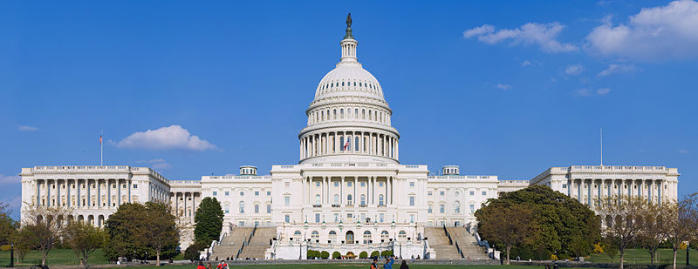
SHRM ADVOCACY TEAM
Advancing the HR Agenda in Public Policy
September 17, 2013

Slide 2
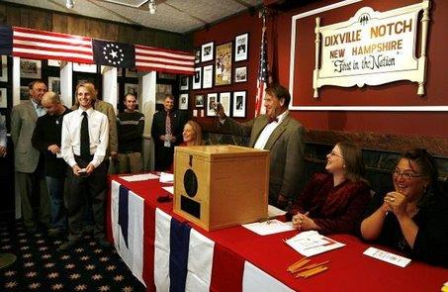
Advocacy comes to the Granite State

Slide 3
You know the “Live Free or Die” state

Slide 4
Actually it’s more like this …

Slide 5
… Ok, maybe that’s a bit over the top, but we do take our politics seriously in this State.

Slide 6
When you take all of that into consideration it is appropriate to refer to our HR advocates as …

Slide 7
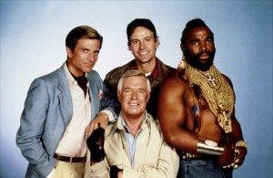
The SHRM A-Team

Slide 8
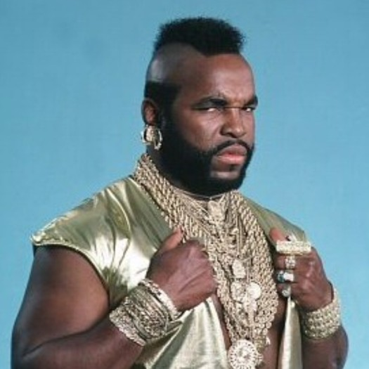
“I pity the fool who doesn’t listen to HR when dealing with workplace laws and regulations.”

Slide 9
What is the A-Team?
The SHRM Advocacy Team has been developed by SHRM Government Affairs as a way to assist HR Advocates — professionals like you — in making their voices heard on public policy issues impacting the workplace.
It’s time that policymakers — both in Washington and in state capitals across the country —understand the role HR plays in today’s workplace.

Slide 10
What does the A-Team do?
The SHRM Advocacy Team is a crucial component of SHRM’s advocacy efforts, and works with you to advance the interests of the HR profession at both the federal and state levels.
As a member of the SHRM Advocacy Team, you will join the ranks of other HR Advocates committed to moving the HR profession forward, and be the voice of our profession.

Slide 11
How does it work?
We have 4 teams in NH
One team for each Senator and Representative in Congress
Each team has a Captain

Slide 12
What does an Advocacy Captain do?
"Advocacy Captains" reside in the congressional district.
Each Advocacy Captain serves as the face of HR within the district and acts as the point of contact for SHRM’s Government Affairs Team when the need for in-district advocacy arises.
They help coordinate Team activities and report progress to SHRM.

Slide 13
And what do the Team members do?
They work with the Captains to get the word out, to canvas HR groups, to gather useful information and to help provide feedback to Legislators.
In other words, they provide anecdotes about how workplace laws or regulations impact the “real world” of NH employers.

Slide 14
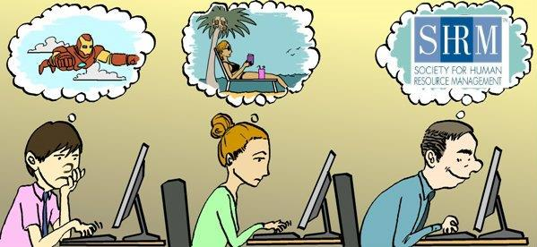
Do we have to think this stuff up ourselves?
No, SHRM provides lots of support with white papers, sample letters, position statement drafts, strategy suggestions, contact information and updates on matters from Capitol Hill.

Slide 15
“Can’t I just stick to watching the news, ‘un-liking’ Congress on Facebook and sending anonymous emails to the Governor?”

Slide 16
Sure, but if you want to be effective, you should join the A-Team!

Slide 17
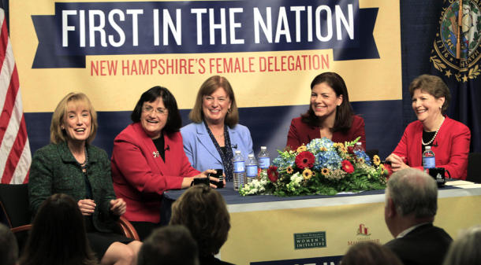
We have already made connections with our Senators and Representatives.

Slide 18
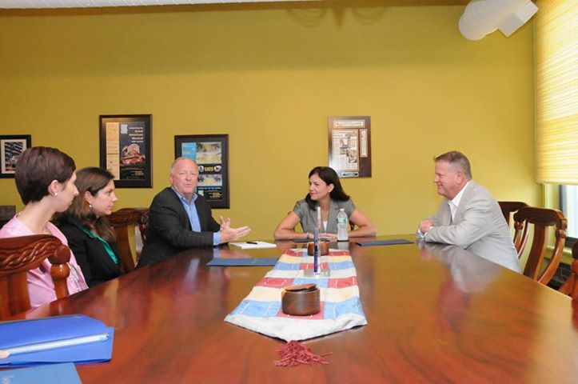
Recently a few of our teams met with staff members to introduce the A-Team and what we can offer.
We also discussed immigration reform and
e-verify.

Slide 19
Congress loves to adopt workplace laws so there will be more meetings in the months and years ahead and there will be more workplace issues to discuss.

Slide 20
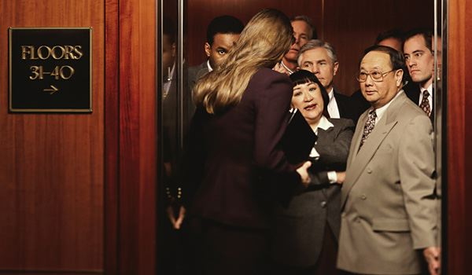
We already have 20 members across the 4 Teams but there is always room for more.

Slide 21
So why not join us?

Slide 22
Here are our Captains:
Charla Stevens – Senator Ayotte
Catherine Mirabile – Senator Shaheen
Rich Murphy – Rep. Shea-Porter
Joe Wentworth – Rep. Kuster

Slide 23
Here is the contact info for our Captains:
Senator Ayotte Charla Stevens charla.stevens@mclane.com | Senator Shaheen Catherine Mirabile cmirabile@cgibenefitsgroup.com
Rep. Shea-Porter Rich Murphy rmurphy@sterilite.com | Rep. Kuster Joe Wentworth jwentworth@wilsonemployment.com

Slide 24
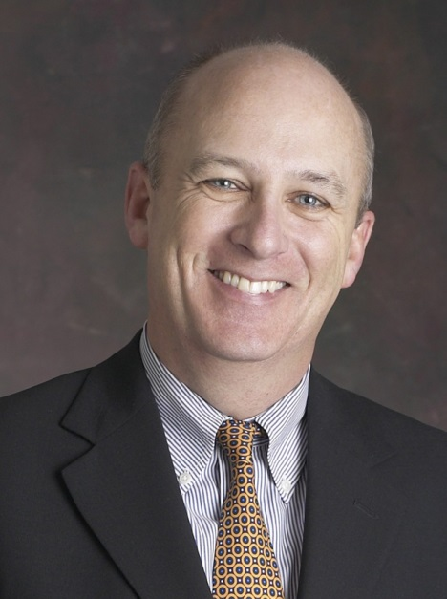
You can always contact me too. Jim Reidy jreidy@sheehan.com (603) 627-8217

Slide 25
Let’s make sure the voice of the
Granite State is heard in Washington!

Slide 26
Thundering applause!

Slide 27
Thanks!
Jim Reidy
HR State Council of NH
Legislative Affairs Chair

