Slide 1
Ego vs. EQ: How Top Leaders Overcome Ego Traps
Presented By:
Jen Shirkani
Prepared For:

Slide 2
Emotional Intelligence (EQ)

Slide 3
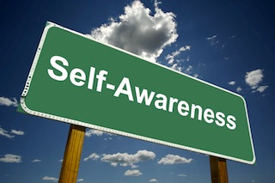
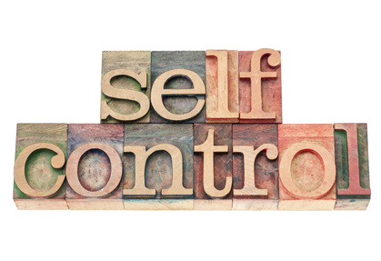
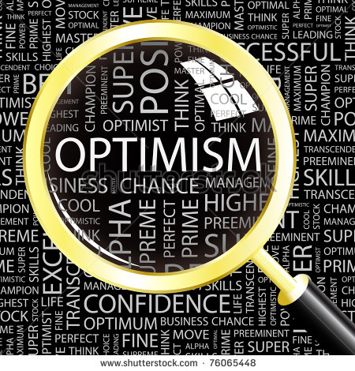
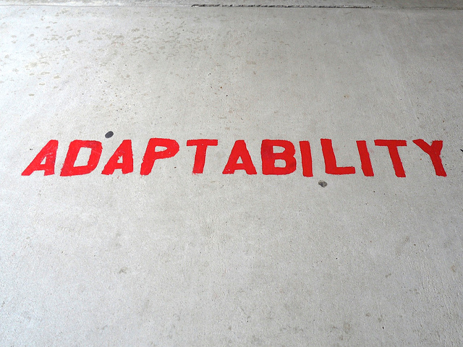
EQ Requires...
Notes:
Don’t know if we need this, perhaps just a few pictures that fly in and I say, EQ is made up of skills like self awareness, self control, flexibility and optimism.

Slide 4
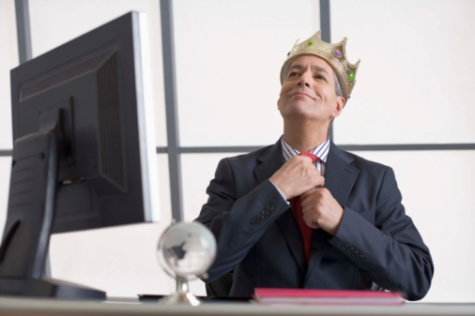
EGO

Slide 5
Ego Triggers
Responsibility and accountability with little direct authority
A belief that it’s our job to fix or save people
Access to confidential information
Type “A” personality
Workload stress
Very high intelligence or technical skills
Fast career ascension
@Shirkani

Slide 6
Stats
Two in five CEO’s fail in the first 18 months on the job
Two thirds of businesses fail in their first ten years
Nearly 100% of CEO’s surveyed said they would like an executive coach but two thirds don’t get one

Slide 7
The Critical Choice
The defining strategy behind why the smartest and most successful executives fail over time or sustain a legacy of greatness.

Slide 8
8 EGO TRAPS
#1 Ignoring Feedback You Don’t Like
#2 Believing Technical Skills Trump Leadership Skills
#3 Surrounding Yourself With More of You
#4 Not Letting Go of Control
#5 Being Blind to Your Downstream Impact
#6 Underestimating How Much You’re Being Watched
#7 Losing Touch with the Frontline Experience
#8 Relapsing Back to Your Old Ways

Slide 9
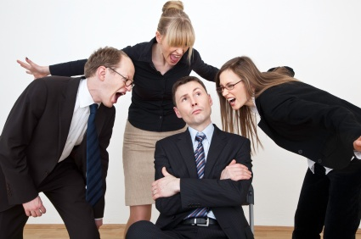
Ignoring feedback

Slide 10
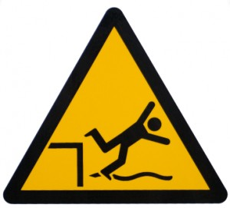
You know you’ve fallen into this trap if….
You think no news is good news.
You assume that since you receive ongoing, honest input about operational issues that your team is being equally forthright in sharing candid feedback about you.

Slide 11
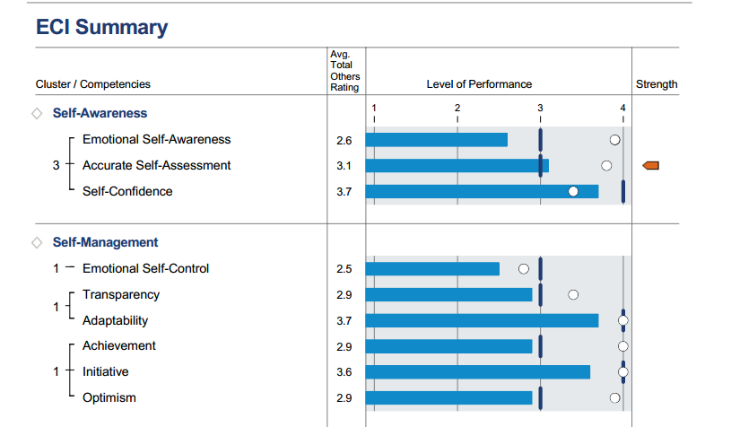

Slide 12
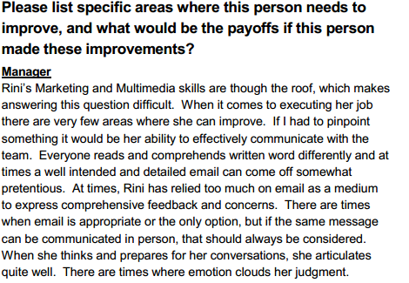

Slide 13
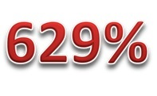
The Importance of Feedback
“In 31 companies, a high self-awareness score was strongest predictor of overall success.”
GP Partners & Cornell U

Slide 14
overcome this trap
Seek out feedback via a 360 assessment
or executive coach and make
self-auditing a habit.

Slide 15
not letting go of control

Slide 16
You know you’ve fallen into this trap if….
Your direct reports avoid independent decision making or critical thinking.
It is difficult for anyone to be held accountable because they can always point the finger back at you.

Slide 17
overcome this trap
Utilize questioning techniques instead
of giving answers too quickly. Honor
delegated commitments. Create
tools to keep you informed without
having to be involved.

Slide 18
being blind to your downstream impact

Slide 19
You know you’ve fallen into this trap if….
You delegate tasks to certain people who you know will get it done, but it’s not their job.
You call last minute-meetings, assuming that everyone will clear their calendar.
And they all show up.

Slide 20
E-ADHD
300%

Slide 21
overcome this trap
Get good at recognizing when your ego
is leading the way – by acting before
taking others into consideration or
implementing “initiatives du jour”.

Slide 22
LOSING TOUCH WITH THE FRONTLINE EXPERIENCE

Slide 23
YOU KNOW YOU’VE FALLEN IN THIS TRAP IF…
You don’t periodically spend time working alongside employees doing work with them.
You have employees you have never met working in locations you have never visited.

Slide 24
OVERCOME THIS TRAP
Schedule time to meet with people
throughout your organization and
take advantage of opportunities that
allow you to have “agenda-less”
conversations.
@Shirkani

Slide 25
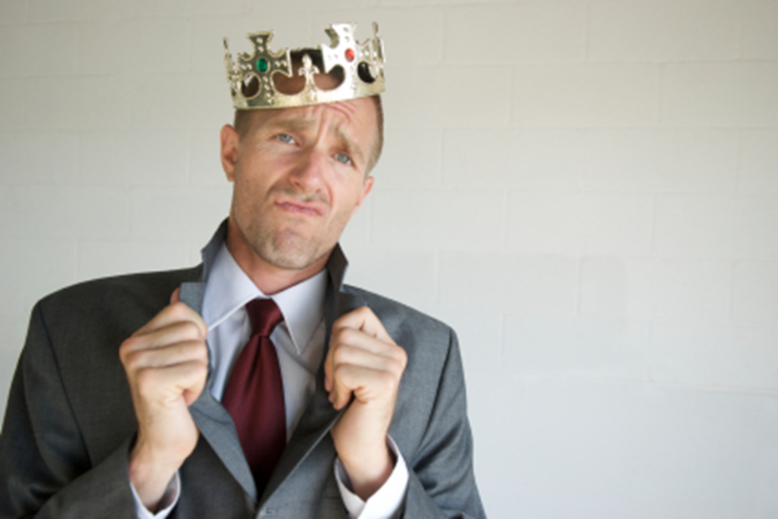
RELAPSING BACK TO YOUR OLD WAYS

Slide 26
You know you’ve fallen into this trap if….
You slide back to comfort zone responses, not making mindful choices in interactions with others.
You are selectively on your best behavior with certain audiences.
Good days you show high EQ. Bad days you let it slide.

Slide 27
overcome this trap
Identify and meet regularly with an
accountability partner. Someone who
will keep you honest to your
commitments.

Slide 28
Free Resource:
www.penumbra.com

Slide 29
Free Resource:

Slide 30
Connect with Me:
@Shirkani

Slide 31
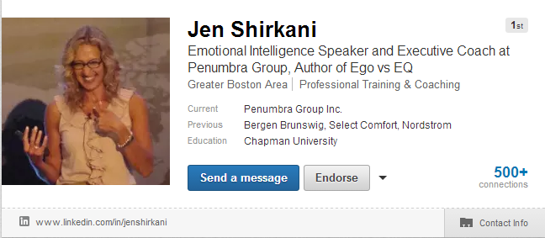
Connect with Me:
www.linkedin.com/in/jenshirkani

Slide 32
www.EgovsEQ.com
Thank You!

